Slide 1
Client-Side MVC Course
DAY 1
Nielarshi
Rias

Slide 2
Agenda
What is JS?
Why to learn JS
Features of JS
Data Types
Variables
Variables Scope
Functions

Slide 3
THE STORY

Slide 4
Need for JS
Developers were dreaming about a language which can
Improve user interaction with the site
Does Form Validation
Add special effects in terms of animations
Dynamic content manipulation
Better web experience via cookies

Slide 5
What is JavaScript?
Developed by Brendan Eich for Netscape
JS is an interpreted language
Primarily designed to add interactivity to site
Works in all major browsers, such as Internet Explorer, Mozilla, Firefox, Netscape, Opera.

Slide 6
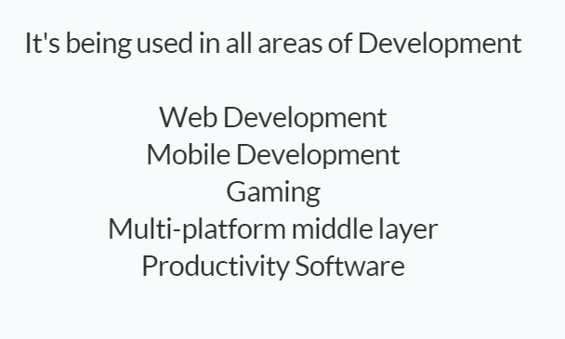
Why should I learn JS?

Slide 7
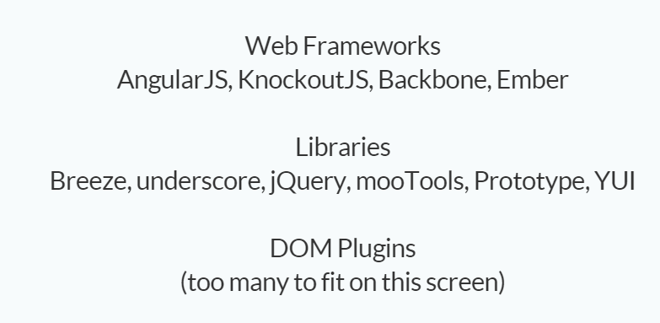
Web Development

Slide 8

Mobile App Development

Slide 9
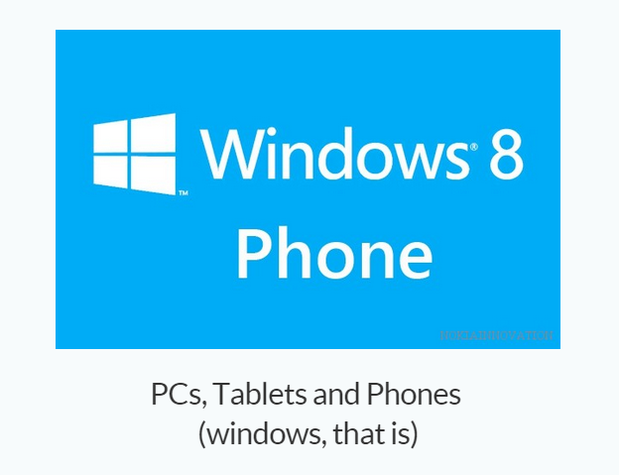
Multi Platform Native

Slide 10
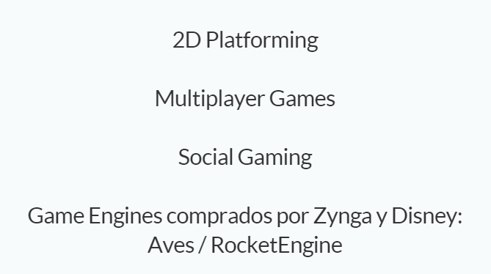
Gaming

Slide 11

Server Side Development

Slide 12
JS Basics – Data Types
Dynamically Typed Language
Primitive data types
  Number: integer & floating-point numbers
  Boolean: logical values “true” or “false”
  String: a sequence of alphanumeric characters
Composite data types (or Complex data types)
  Object: a named collection of key value pair
  Array: a sequence of values
Special data types
  Null: an initial value is assigned
  Undefined: the variable has been created by not yet assigned a value

Slide 13
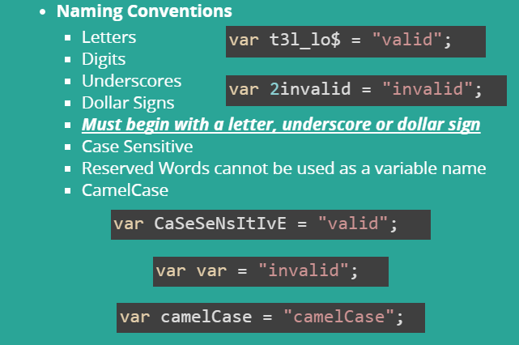
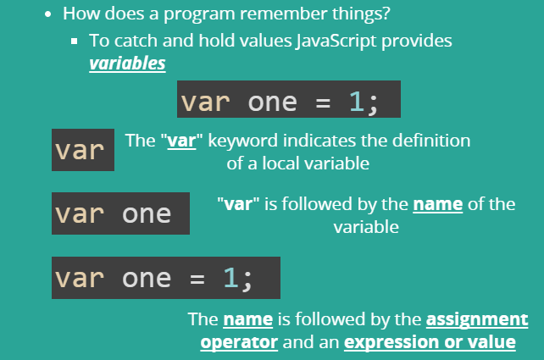
Variables

Slide 14
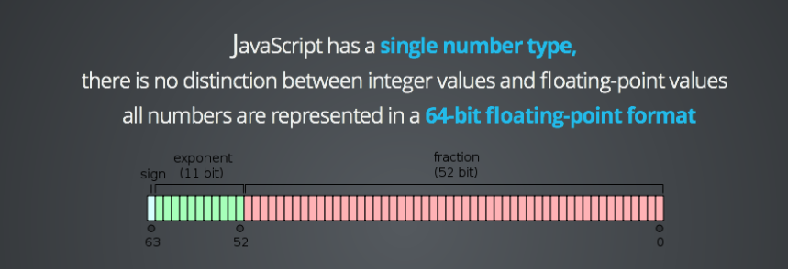
NUMBERS

Slide 15
Boolean
There are only two values possible for this type true or false
Any value can be converted to boolean value:
undefined, null, 0, -0, NaN, “” convert to false, are called falsy values
all other values convert to true, are called truthy values

Slide 16
ARITHMETIC OPERATIONS
Result of a numeric operation is larger than the largest representable number
Division by zero
Divide Infinity by Infinity
Take the square root of a negative number

Slide 17
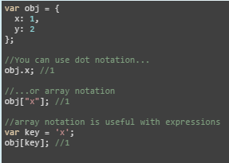
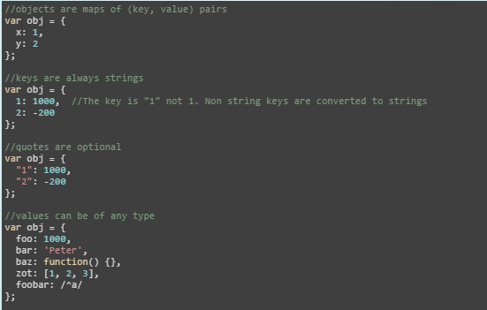
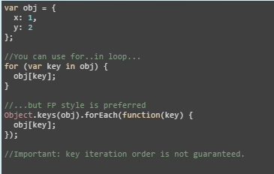
JavaScript Objects

Slide 18
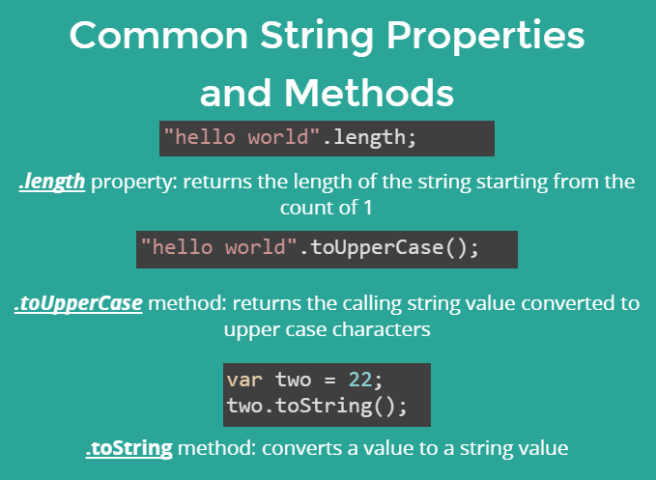
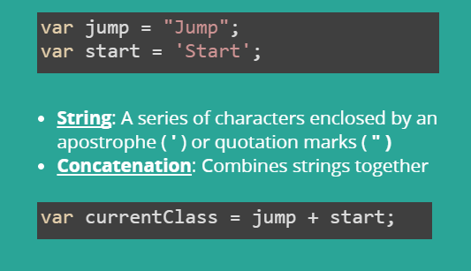
Strings

Slide 19
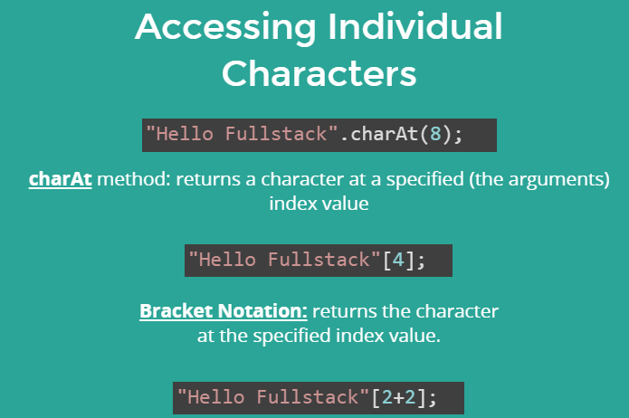
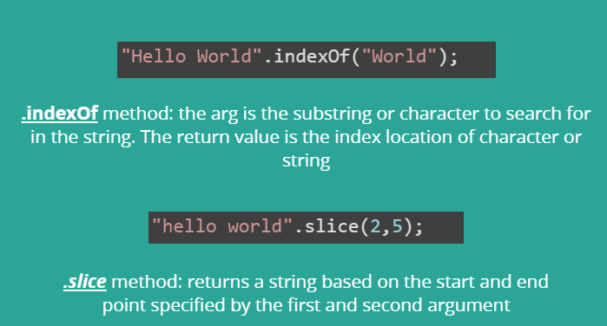
Common String Methods

Slide 20
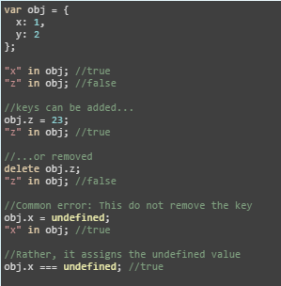
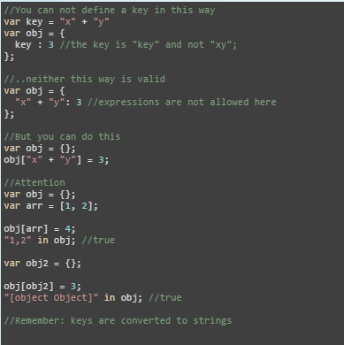
Objects – Cont.
Dynamic Objects
Expressions in Objects

Slide 21
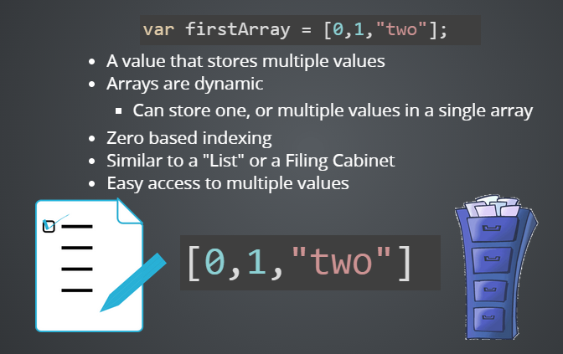
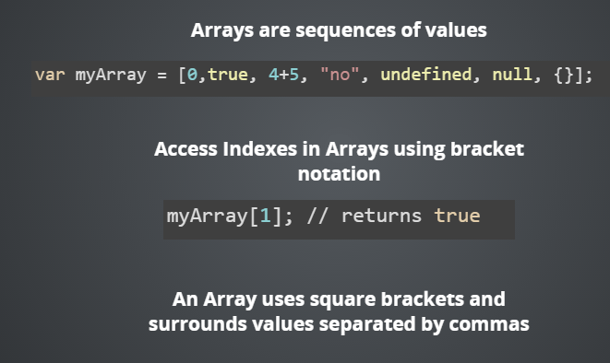
Arrays

Slide 22
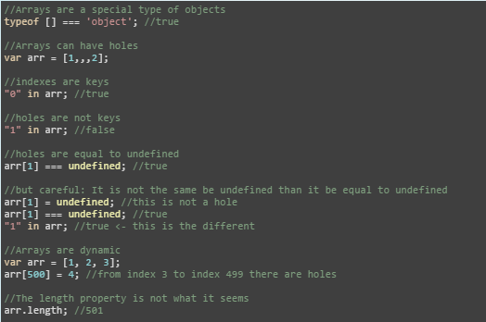
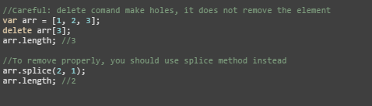
Arrays – Cont.

Slide 23
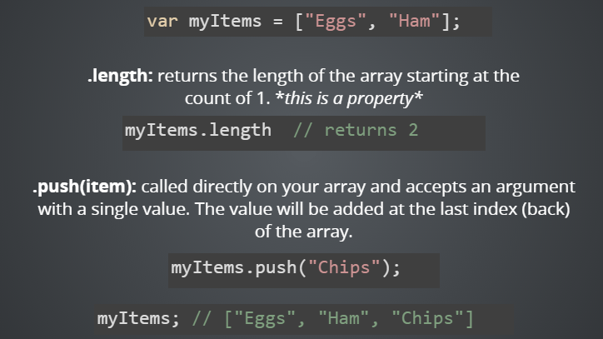
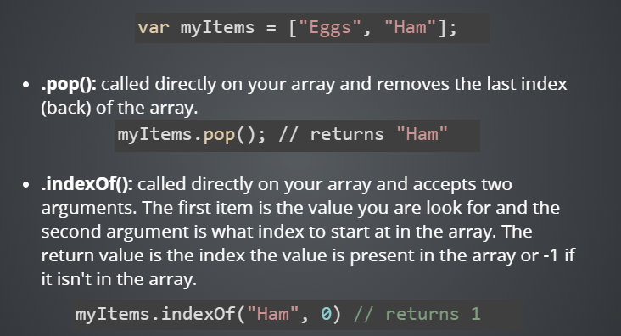
Arrays Methods

Slide 24
NULL & Undefined
Null is a language keyword that evaluates to a special value that is usually used to indicate the
absence of a value
Undefined is a predefined global variable which indicates the absence of value
of variables that have not been initialized.
Query the value of an object property or array element that does not exist
Returned by functions that have no return value
Function parameters for which no argument is supplied

Slide 25
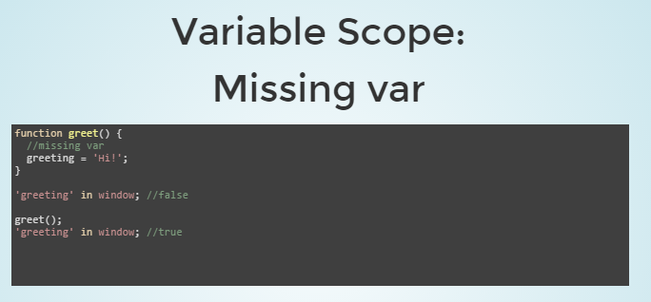
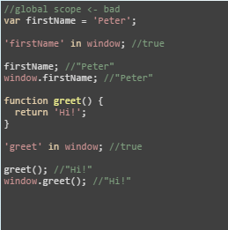

Global Variables

Slide 26
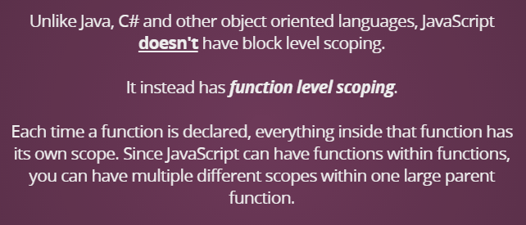
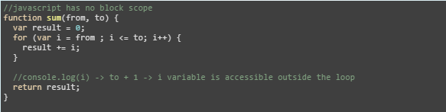
Function Scoping

Slide 27
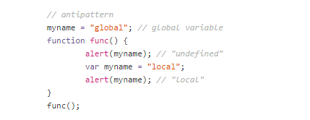
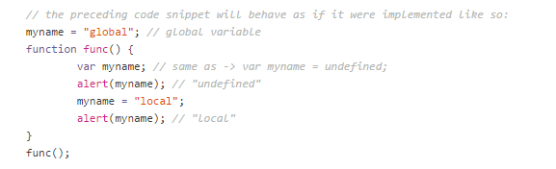
Variable Hoisting

Slide 28
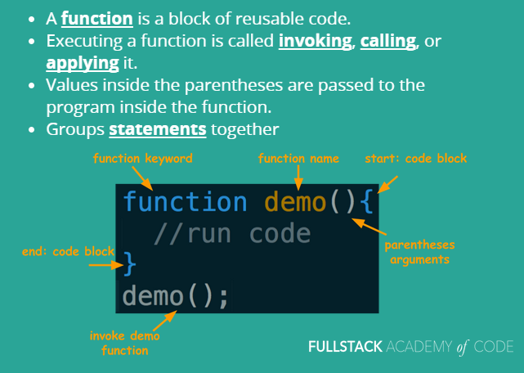
Functions

Slide 29

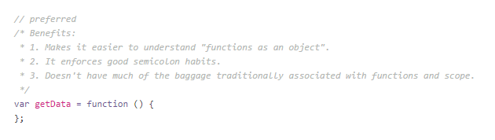
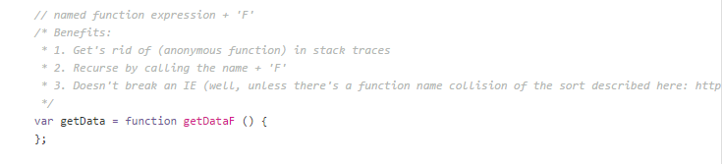
Function Declaration Types

Slide 30
Function Declaration Types

Slide 31
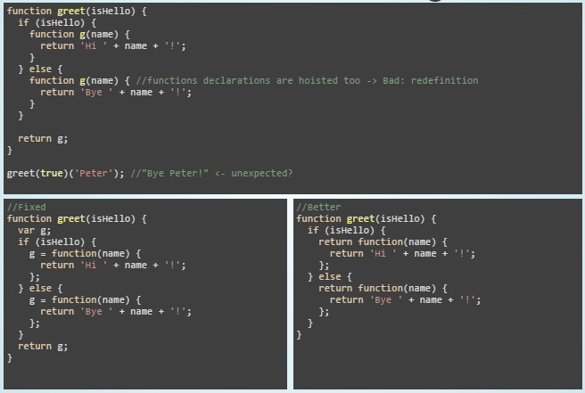
Function Hoisting

Slide 32
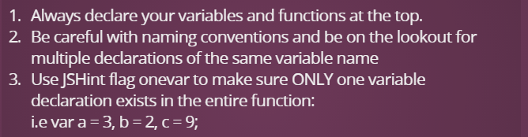
Ways to avoid Hoisting and scoping issues

Slide 33
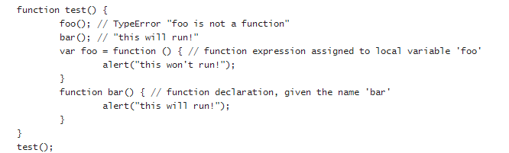
Example 1

Slide 34
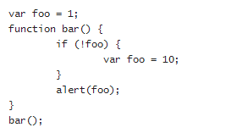
Example 2

Slide 35
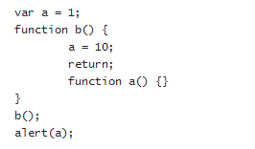
Example 3

Slide 36
Example 4
function A() {
var c = d = 10;
}
A()
console.log(c);
console.log(d);

Slide 37
Next Week
Functions in-depth
Closures
Inheritance in JS

